Slide 1
COVID 19 Detection and Forecasting
https://data.gov.il/dataset/covid-19

Slide 2
Group Members
Noman Anjum 17K-3755
Muhammad Mustafa Manga 17K-3795
Data Science Project Report Supervisor:
Dr. Atif Tahir
CEO
CFO
Sales Director
Berry Books
Vinny Viewer
Wendy Writer

Slide 3
Introduction
Coronavirus disease 2019 (COVID-19), also known as the coronavirus, or COVID, is a contagious disease caused by severe acute respiratory syndrome coronavirus 2 (SARS-CoV-2).. The first known case was identified in Wuhan, China, in December 2019. The disease has since spread worldwide, leading to an ongoing devastating pandemic. Symptoms of COVID-19 are variable, but often include fever, cough, headache, fatigue, breathing difficulties, and loss of smell and taste. Symptoms may begin one to fourteen days after exposure to the virus.

Slide 4
Problems to solve
• Detection/Classification Of COVID 19 with the help of potential symptoms.
1
2
• Time series forecasting for number of cases of COVID 19.

Slide 5
Data Collection
Primary data we needed for our research should essentially have samples containing different symptoms and a feature defining whether sample was diagnosed with COVID 19 or Not.
Also We needed aggregated dataset over (week or months) with number of positive COVID cases to perform time series analysis.

Slide 6
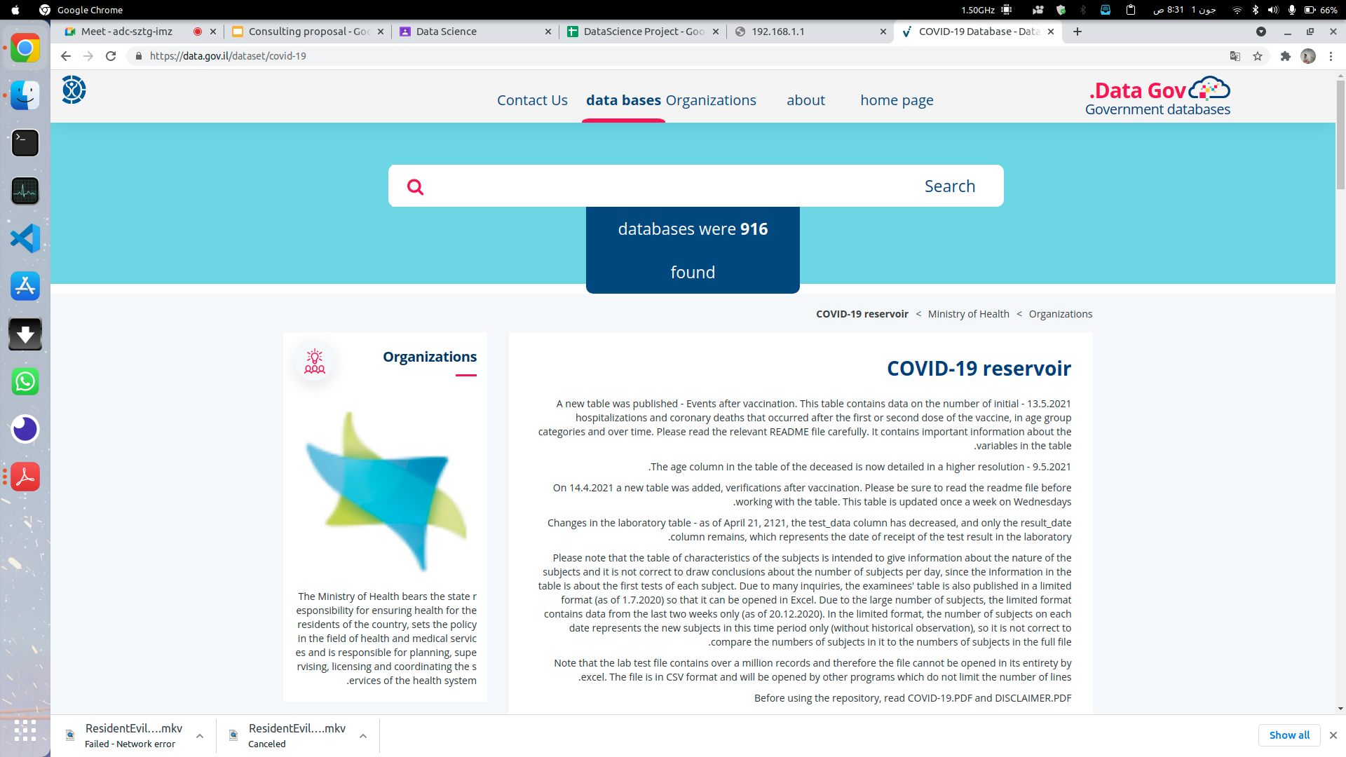
Data Source

Slide 7
Data Preparation

Slide 8
Removal Of Missing Values
Replacing Hebrew With English
Aggregation For Time Series Analysis

Slide 9
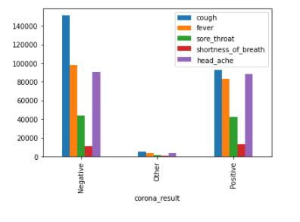
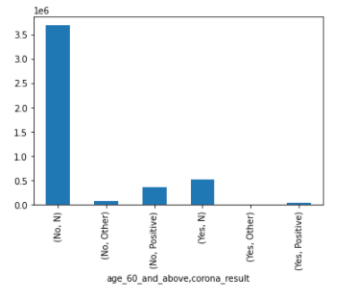
Visualizations & Insights
Frequency Of Symptoms For Positive and Negative Cases
Age Factor and Spread Of COVID

Slide 10
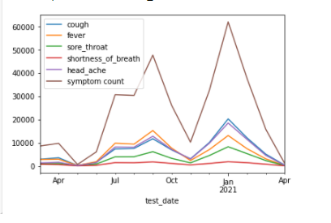
Cont.
Trend Of Symptoms With respect to rise in COVID 19

Slide 11
Models
Naive Bayes
Decision Tree
Random Forest
MultiLayer Perceptron
Voting Classifier

Slide 12
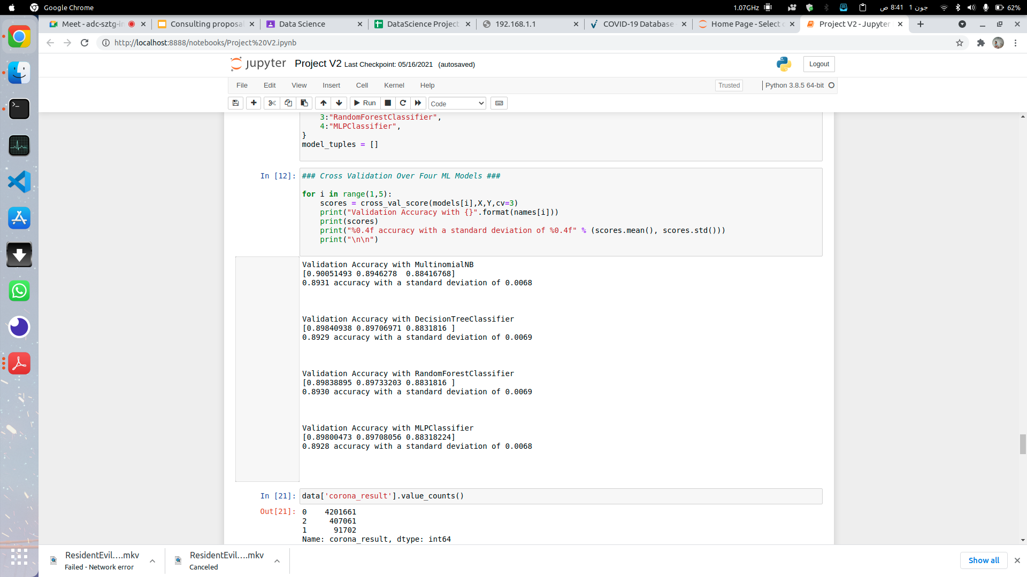
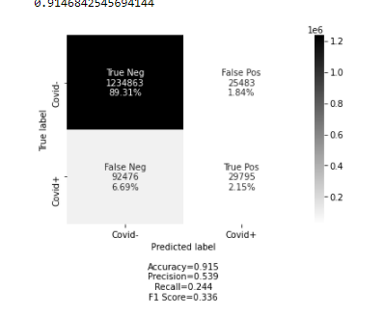
Models & Accuracy

Slide 13
Time Series Analysis
• ARIMA with and without XGBoost
• xponential Smoothing (ets)
• Prophet
• MARS/EARTH
• Linear Regression (Parsnip)
• Prophet With XGBoost
• RandomForest
• GLMNET

Slide 14
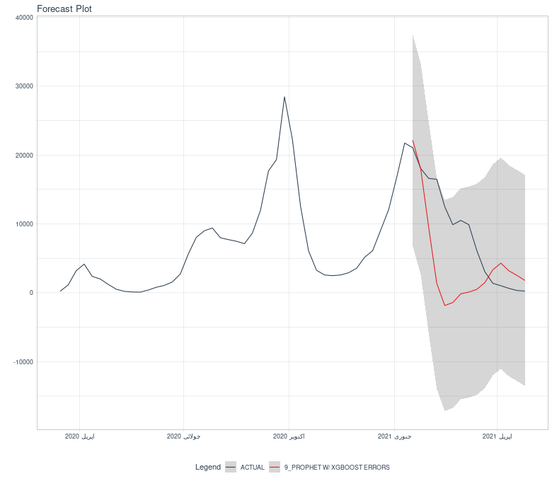
Weekly Corona Train Uni Variate

Slide 15
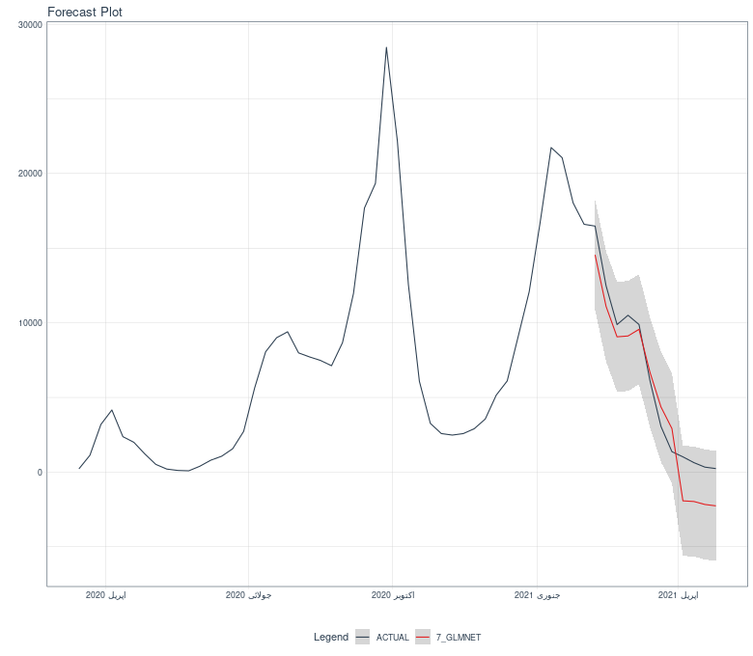
Weekly Corona Train Multi Variate

Slide 16
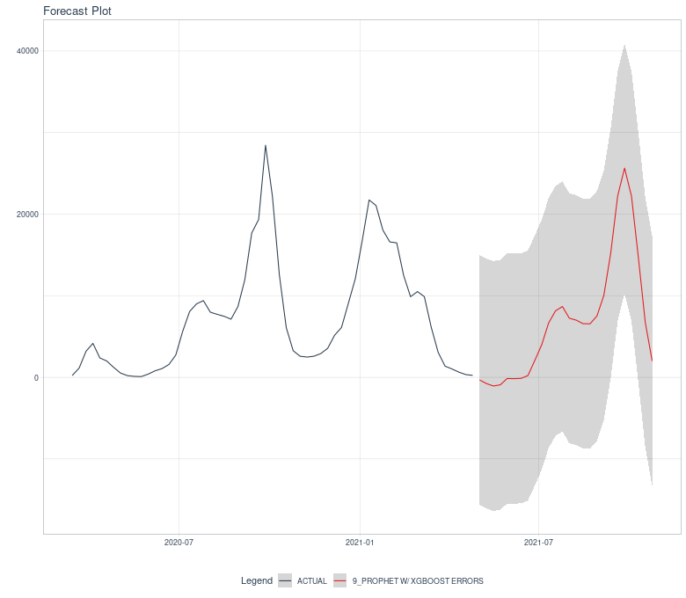
Weekly Corona Forecast Uni Variate

Slide 17
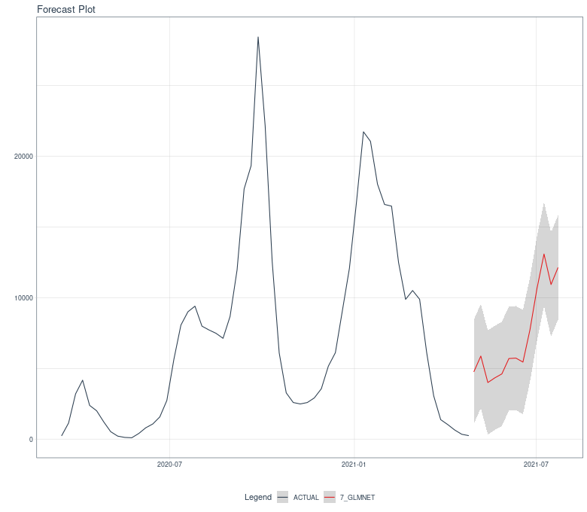
Weekly Corona Forecast Multi Variate

Slide 18
Thank you.

